Slide 1

VNR VIGNANA JYOTHI INSTITUTE OF ENGINEERING AND TECHNOLOGY
COMPUTER SCIENCE AND ENGINEERING DEPARTMENT
A HYBRID MACHINE LEARNING-BASED SMART HOME IOT SECURITY SYSTEM FOR THREAT DETECTION, CLASSIFICATION, AND ALERT MECHANISMS
Guide
Mr P. Praveen
Assistant Professor
Department of CSE
TEAM MEMBERS:
22071A0518-G.ABHISHEK GOUD
22071A0521-G.SAI SRUJITH
22071A0559-V.PAVAN KUMAR
22071A0564-Y.SAKETH

Slide 2
VNR VIGNANA JYOTHI INSTITUTE OF ENGINEERING AND TECHNOLOGY
COMPUTER SCIENCE AND ENGINEERING DEPARTMENT
AGENDA
Abstract
Introduction
Literature Review
Existing System & Limitations
Proposed System
System Requirements
Objectives
Architecture
Methodology
System Design
Implementation
Conclusion
Future Scope
Work Plan
References
A Hybrid Machine Learning-Based Smart Home IoT Security System for Threat Detection, Classification, and Alert Mechanisms

Slide 3
VNR VIGNANA JYOTHI INSTITUTE OF ENGINEERING AND TECHNOLOGY
COMPUTER SCIENCE AND ENGINEERING DEPARTMENT
ABSTRACT
The rapid growth of Internet of Things (IoT) devices in smart home environments has increased the risk of cyber-attacks, making security a critical concern. This project presents an IoT-based smart home security system that detects and classifies network anomalies using machine learning techniques. A smart bulb controlled through ESP32 devices is used to simulate real-time IoT communication, and network traffic is captured under both normal and attack conditions using Wireshark. The collected data is preprocessed through feature cleaning, encoding, scaling, and dimensionality reduction using Principal Component Analysis (PCA). A hybrid approach is implemented where Local Outlier Factor (LOF) is used for anomaly detection and Random Forest is used for attack classification. The system identifies normal traffic, known attacks, and abnormal patterns based on confidence scores. An automated email alert mechanism is integrated to notify users of detected threats. Experimental results demonstrate that the system effectively detects anomalies and provides reliable classification, making it suitable for enhancing security in IoT-based smart home environments.
A Hybrid Machine Learning-Based Smart Home IoT Security System for Threat Detection, Classification, and Alert Mechanisms

Slide 4
VNR VIGNANA JYOTHI INSTITUTE OF ENGINEERING AND TECHNOLOGY
COMPUTER SCIENCE AND ENGINEERING DEPARTMENT
INTRODUCTION
The increasing adoption of Internet of Things (IoT) devices in smart home environments has significantly enhanced automation and user convenience, but it has also introduced serious security vulnerabilities. Devices such as smart bulbs and controllers communicate continuously over networks, making them potential targets for cyber-attacks including brute force, replay, and man-in-the-middle attacks. Conventional security mechanisms are often insufficient in such environments due to limited device resources and the dynamic nature of network traffic. To address these challenges, this project presents a smart home security system that captures IoT network traffic and applies a hybrid machine learning approach for threat detection. The system uses Local Outlier Factor (LOF) to detect anomalies and a Random Forest classifier to identify attack types. With a consistent preprocessing pipeline and an alert mechanism for detected threats, the system provides an effective solution for monitoring and enhancing security in IoT-based smart home environments.
A Hybrid Machine Learning-Based Smart Home IoT Security System for Threat Detection, Classification, and Alert Mechanisms

Slide 5
VNR VIGNANA JYOTHI INSTITUTE OF ENGINEERING AND TECHNOLOGY
COMPUTER SCIENCE AND ENGINEERING DEPARTMENT
LITERATURE REVIEW
A Hybrid Machine Learning-Based Smart Home IoT Security System for Threat Detection, Classification, and Alert Mechanisms

Slide 6
S.No | Paper title,Year of Publication | Problem addressed | Objective of the research | Focus of the paper | Inference | Recommendations for future research | How can our research help bridge the gap
1
VNR VIGNANA JYOTHI INSTITUTE OF ENGINEERING AND TECHNOLOGY
COMPUTER SCIENCE AND ENGINEERING DEPARTMENT
Design and Implementation of Automated IoT Security Testbed.
Published in 2020.
Real consumer devices hide security problems that simple lab tests miss.
Researchers needed a repeatable testbed to show real attacks on real devices.
Make an automated testbed to run attacks and collect evidence.
Show how common devices (like bulbs) react to network attacks.
They built a controlled lab and scripted attacks to test devices.
They recorded traffic and device responses to measure vulnerabilities.
Many off-the-shelf devices accept malicious or replayed commands.
Safety controls on these devices are often weak or missing.
Create more testbeds and test more kinds of devices and protocols.
Add detection and defenses to reduce easy attacks in real homes.
We build a low-cost ESP32 + MQTT testbed and record labeled traces.
Our work adds anomaly detection and shows how defenses reduce attacks.
A Hybrid Machine Learning-Based Smart Home IoT Security System for Threat Detection, Classification, and Alert Mechanisms

Slide 7
S.No | Paper title,Year of Publication | Problem addressed | Objective of the research | Focus of the paper | Inference | Recommendations for future research | How can our research help bridge the gap
2
VNR VIGNANA JYOTHI INSTITUTE OF ENGINEERING AND TECHNOLOGY
COMPUTER SCIENCE AND ENGINEERING DEPARTMENT
IoT Inspector: Crowdsourcing Labeled Network Traffic.
Published in 2019.
There were not enough large, labeled datasets of real smart-home traffic.
This made it hard to train and test detection algorithms.
Collect many labeled device traffic records from real homes.
Provide a dataset researchers can use for analysis and ML.
They used a software tool to collect traffic and user labels at scale.
They aggregated data from thousands of devices and many homes.
Device behavior varies widely and many devices contact trackers or cloud services.
Large labeled datasets reveal patterns not visible in small lab tests.
Use crowdsourced data for ML and to study device ecosystems.
Combine large-scale in-the-wild data with controlled lab traces.
We add ground-truth lab data of normal vs attack behavior to the crowdsourced mix.
This helps ML models learn both realistic and attack patterns with labels.
A Hybrid Machine Learning-Based Smart Home IoT Security System for Threat Detection, Classification, and Alert Mechanisms

Slide 8
S.No | Paper title,Year of Publication | Problem addressed | Objective of the research | Focus of the paper | Inference | Recommendations for future research | How can our research help bridge the gap
3
VNR VIGNANA JYOTHI INSTITUTE OF ENGINEERING AND TECHNOLOGY
COMPUTER SCIENCE AND ENGINEERING DEPARTMENT
HoMonit: Monitoring Smart Home Apps from Encrypted Traffic.
Published in 2018.
Encrypted traffic hides app actions so bad behavior is hard to spot.
Simple packet capture does not show app logic inside TLS.
Detect app misbehavior using side-channel features like size and timing.
Infer app workflows from patterns in encrypted traffic.
They build models (DFAs) that match app logic with traffic patterns.
They compare observed encrypted flows to expected app behavior.
Side-channel features (timing, packet size) reveal app actions despite TLS.
This lets monitors detect abnormal app behavior without decrypting.
Combine code analysis with traffic monitoring for stronger detection.
Refine side-channel models for more app types and richer features.
We use MQTT timing, message rates and topic patterns as side-channel features.
Our ML detector checks these patterns to spot replay or flood attacks.
A Hybrid Machine Learning-Based Smart Home IoT Security System for Threat Detection, Classification, and Alert Mechanisms

Slide 9
S.No | Paper title,Year of Publication | Problem addressed | Objective of the research | Focus of the paper | Inference | Recommendations for future research | How can our research help bridge the gap
4
VNR VIGNANA JYOTHI INSTITUTE OF ENGINEERING AND TECHNOLOGY
COMPUTER SCIENCE AND ENGINEERING DEPARTMENT
NDSS paper (ID 24097) on smart-home system vulnerabilities.
Published in 2020.
Smart-home ecosystems have many chained weaknesses across devices and cloud.
Single-device fixes do not stop attacks that cross components.
Analyze system-level attack paths and demonstrate exploits.
Show how multi-step attacks can affect the whole home.
They performed empirical tests and modeled vulnerability chains.
They used repeatable experiments to show real attack outcomes.
Many attack paths exist and small flaws can cause large impact.
Defenses must consider the whole system, not only one device.
Prioritize fixes that reduce the largest attack impact first.
Build tools that find and block multi-step attack chains.
We include an attacker ESP32 and log end-to-end flows to map attack chains.
Our ML alerts are tested against these chains to see if they catch system-level attacks.
A Hybrid Machine Learning-Based Smart Home IoT Security System for Threat Detection, Classification, and Alert Mechanisms

Slide 10
S.No | Paper title,Year of Publication | Problem addressed | Objective of the research | Focus of the paper | Inference | Recommendations for future research | How can our research help bridge the gap
5
VNR VIGNANA JYOTHI INSTITUTE OF ENGINEERING AND TECHNOLOGY
COMPUTER SCIENCE AND ENGINEERING DEPARTMENT
Characterizing Smart-Home IoT Traffic in the Wild.
Published in 2020 (IoTDI).
Lab studies miss how devices behave in real homes under real workloads.
Large-scale, real-use patterns were not well documented.
Measure device behavior in real homes and report patterns and issues.
Compare passive observations with scan-based results.
They passively observed device traffic in many homes and studied contacts.
They analyzed TLS usage, trackers, and unusual behavior patterns.
Real homes show insecure configurations and many third-party connections.
Device behavior depends on user actions and cloud services.
Combine passive data with active experiments and lab tests for full view.
Study device-specific behavior and cloud interactions more deeply.
We produce labeled lab data (normal vs attack) to complement wild observations.
This helps build detectors that work both in lab and in real homes.
A Hybrid Machine Learning-Based Smart Home IoT Security System for Threat Detection, Classification, and Alert Mechanisms

Slide 11
S.No | Paper title,Year of Publication | Problem addressed | Objective of the research | Focus of the paper | Inference | Recommendations for future research | How can our research help bridge the gap
6
VNR VIGNANA JYOTHI INSTITUTE OF ENGINEERING AND TECHNOLOGY
COMPUTER SCIENCE AND ENGINEERING DEPARTMENT
Who Let the Smart Toaster Hack the House? (large-scale experiments).
Published in 2023.
Do common consumer IoT devices still fail under standard network attacks?
Researchers wanted systematic results on many devices.
Run many automated attacks on multiple devices and record results.
Understand which devices fail and how.
They used testbeds to run scans, floods, and intercepts on many devices.
They logged behavior and measured attack success and device reactions.
Many devices remain vulnerable and lack built-in detection.
Consumer IoT often has weak defenses and responds poorly under attack.
Share tools and data and push vendors to add embedded protections.
Build monitoring that can run in home networks to detect attacks early.
We provide a small, repeatable testbed to replicate such attacks on MQTT devices.
Our ML detector shows how lightweight monitoring can flag attacks in home networks.
A Hybrid Machine Learning-Based Smart Home IoT Security System for Threat Detection, Classification, and Alert Mechanisms

Slide 12
S.No | Paper title,Year of Publication | Problem addressed | Objective of the research | Focus of the paper | Inference | Recommendations for future research | How can our research help bridge the gap
7
VNR VIGNANA JYOTHI INSTITUTE OF ENGINEERING AND TECHNOLOGY
COMPUTER SCIENCE AND ENGINEERING DEPARTMENT
SoK: Security Evaluation of Home-Based IoT Deployments.
Published in 2019.
Research on home IoT is fragmented and risks are not compared uniformly.
Practitioners need a clear taxonomy of threats and defenses.
Systematize IoT threats and summarize known attacks and mitigations.
Provide an organized view of where research and fixes are needed.
They surveyed literature and made a threat model and taxonomy.
They discussed cloud, hub, device, and network issues for homes.
Weak defaults, poor authentication, and cloud problems are common.
A combined approach (config + auth + monitoring) is necessary.
Harden defaults, require better auth, and study cloud-related risks.
Create standard testbeds and datasets for better research comparisons.
We enforce better MQTT credentials and ACLs on our broker and test results.
We produce datasets and detection scripts that others can reuse and compare.
A Hybrid Machine Learning-Based Smart Home IoT Security System for Threat Detection, Classification, and Alert Mechanisms

Slide 13
S.No | Paper title,Year of Publication | Problem addressed | Objective of the research | Focus of the paper | Inference | Recommendations for future research | How can our research help bridge the gap
8
VNR VIGNANA JYOTHI INSTITUTE OF ENGINEERING AND TECHNOLOGY
COMPUTER SCIENCE AND ENGINEERING DEPARTMENT
IOTA: Attack-Graph Verification for IoT Systems.
Published in 2022.
Securing components separately misses how attacks combine across systems.
Teams need tools to find likely attack paths and their impact.
Build a framework that computes attack graphs and finds short, risky attack paths.
Help defenders prioritize fixes by impact.
They model devices and services as nodes and compute reachable attack steps.
They use graph algorithms to find minimal attack traces and blast radius.
Many unexpected attack chains exist; small flaws can create big exposures.
Attack graphs help find the most dangerous fixes to apply first.
Use graph tools for planning defenses and to validate security changes.
Integrate runtime monitoring to confirm possible attack paths are blocked.
We map our ESP32 + bulb flows to simple attack graphs and test detection on those paths.
This links practical monitoring with formal attack-path analysis.
A Hybrid Machine Learning-Based Smart Home IoT Security System for Threat Detection, Classification, and Alert Mechanisms

Slide 14
S.No | Paper title,Year of Publication | Problem addressed | Objective of the research | Focus of the paper | Inference | Recommendations for future research | How can our research help bridge the gap
9
VNR VIGNANA JYOTHI INSTITUTE OF ENGINEERING AND TECHNOLOGY
COMPUTER SCIENCE AND ENGINEERING DEPARTMENT
Smart-Home IoT traffic and behavior studies from UC Davis group.
Published around 2020.
Device behavior and security practices were not well measured in homes.
More empirical evidence was needed on real device habits.
Observe devices over time and report insecure patterns and endpoints.
Show how devices contact clouds and trackers in practice.
They used passive observation and compared results with scanning tools.
They documented insecure protocols and unusual device behavior.
Many devices use weak settings, contact many third parties, and leak metadata.
Real-use studies reveal problems not visible in lab-only tests.
Combine passive monitoring with targeted active tests and lab validation.
Create datasets and tools for continued measurement.
We add controlled attack traces to complement passive home data.
This helps build detectors that detect anomalies both in lab and in the wild.
A Hybrid Machine Learning-Based Smart Home IoT Security System for Threat Detection, Classification, and Alert Mechanisms

Slide 15
S.No | Paper title,Year of Publication | Problem addressed | Objective of the research | Focus of the paper | Inference | Recommendations for future research | How can our research help bridge the gap
10
VNR VIGNANA JYOTHI INSTITUTE OF ENGINEERING AND TECHNOLOGY
COMPUTER SCIENCE AND ENGINEERING DEPARTMENT
Design and Implementation of Automated IoT Security Testbed (duplicate entry).
Published in 2020.
Devices are vulnerable to simple replays and automated attacks.
A repeatable lab is needed to show these weaknesses.
Build an automated testbed and demonstrate attacks on smart devices.
Record how devices accept unauthorized commands and log evidence.
They used scripted attacks, device enrollment, and traffic analysis.
They measured device behavior and attack success rates.
Many devices accept replayed or forged commands without checks.
Device makers often do not enforce checks against simple network attacks.
Add authentication, monitoring, and standardized testbeds for comparison.
Share datasets and tools for the research community.
We implement per-device credentials, ACLs, and anomaly detection in a cheap testbed.
We verify defenses by comparing before/after attack captures and metrics.
A Hybrid Machine Learning-Based Smart Home IoT Security System for Threat Detection, Classification, and Alert Mechanisms

Slide 16
S.No | Paper title,Year of Publication | Problem addressed | Objective of the research | Focus of the paper | Inference | Recommendations for future research | How can our research help bridge the gap
11
VNR VIGNANA JYOTHI INSTITUTE OF ENGINEERING AND TECHNOLOGY
COMPUTER SCIENCE AND ENGINEERING DEPARTMENT
VFuzz – Riding the IoT Wave with Vulnerability Fuzzing, published in 2019.
Smart home IoT devices often contain hidden security flaws that are difficult to detect through traditional manual testing.
To design a tool that automatically finds vulnerabilities in IoT devices using fuzzing techniques.
VFuzz injects random and structured inputs into device firmware and network services to observe unusual behavior or crashes.
The tool successfully detected critical vulnerabilities in several widely used smart home devices.
Use automated fuzz testing early in IoT product development to identify flaws before release.
Our IoT testbed also performs controlled attack traffic analysis to uncover weak behavior patterns in real devices.
A Hybrid Machine Learning-Based Smart Home IoT Security System for Threat Detection, Classification, and Alert Mechanisms

Slide 17
S.No | Paper title,Year of Publication | Problem addressed | Objective of the research | Focus of the paper | Inference | Recommendations for future research | How can our research help bridge the gap
12
VNR VIGNANA JYOTHI INSTITUTE OF ENGINEERING AND TECHNOLOGY
COMPUTER SCIENCE AND ENGINEERING DEPARTMENT
Gotham – A Scalable IoT Security Testbed, published in 2022.
Many IoT research systems rely on simulations, lacking realistic environments for evaluating real-world attacks.
To create a flexible and scalable cyber range that supports attack simulation and behavior analysis.
Gotham integrates both emulated and real IoT devices to collect attack and normal traffic for machine learning studies.
The testbed produced high-quality datasets that improved the training of intrusion detection systems.
Future work should include a wider variety of devices and more advanced attack patterns.
Our project follows a similar design by using ESP32-based devices to produce real network data and simulate attacks.
A Hybrid Machine Learning-Based Smart Home IoT Security System for Threat Detection, Classification, and Alert Mechanisms

Slide 18
S.No | Paper title,Year of Publication | Problem addressed | Objective of the research | Focus of the paper | Inference | Recommendations for future research | How can our research help bridge the gap
13
VNR VIGNANA JYOTHI INSTITUTE OF ENGINEERING AND TECHNOLOGY
COMPUTER SCIENCE AND ENGINEERING DEPARTMENT
ANTsiot – Automated Network Testing for IoT Systems, introduced in 2017.
Manual network security testing is slow and inefficient for the large number of IoT devices.
To automate vulnerability testing of IoT networks for quicker and more accurate analysis.
ANTsiot performs network scans, packet injections, and protocol tests to find security loopholes automatically.
The system effectively identified insecure configurations and communication weaknesses.
Combine automation with real devices for deeper security testing and continuous monitoring.
Our project applies this idea by automating MQTT communication checks between ESP32 devices for weak points.
A Hybrid Machine Learning-Based Smart Home IoT Security System for Threat Detection, Classification, and Alert Mechanisms

Slide 19
S.No | Paper title,Year of Publication | Problem addressed | Objective of the research | Focus of the paper | Inference | Recommendations for future research | How can our research help bridge the gap
14
VNR VIGNANA JYOTHI INSTITUTE OF ENGINEERING AND TECHNOLOGY
COMPUTER SCIENCE AND ENGINEERING DEPARTMENT
A Realistic IoT Intrusion Detection Dataset, released in 2023.
Older IoT datasets fail to capture new attack patterns and modern device behaviors.
To create an updated dataset that includes data from real IoT devices under normal and attack conditions.
Researchers collected large-scale traffic using various IoT devices, such as cameras and sensors, for ML training.
Machine learning algorithms achieved high detection accuracy using this new dataset.
Continuously update datasets as IoT devices evolve and new threats appear.
Our testbed generates real MQTT data that can contribute to future intrusion detection datasets.
A Hybrid Machine Learning-Based Smart Home IoT Security System for Threat Detection, Classification, and Alert Mechanisms

Slide 20
S.No | Paper title,Year of Publication | Problem addressed | Objective of the research | Focus of the paper | Inference | Recommendations for future research | How can our research help bridge the gap
15
VNR VIGNANA JYOTHI INSTITUTE OF ENGINEERING AND TECHNOLOGY
COMPUTER SCIENCE AND ENGINEERING DEPARTMENT
ManSupport – Managing IoT Security through Prototyping, published in 2022.
IoT projects often fail due to poor management and lack of a structured security validation process.
To propose a model for better project planning, testing, and evaluation in IoT security development.
The study used scenario-based prototypes and monitoring frameworks to manage IoT research efficiently.
Organized management improves IoT development reliability and team productivity.
Integrate structured workflows with real testing platforms to achieve more practical outcomes.
Our project combines structured research planning with a real IoT testbed for better validation and results.
A Hybrid Machine Learning-Based Smart Home IoT Security System for Threat Detection, Classification, and Alert Mechanisms

Slide 21
S.No | Paper title,Year of Publication | Problem addressed | Objective of the research | Focus of the paper | Inference | Recommendations for future research | How can our research help bridge the gap
16
VNR VIGNANA JYOTHI INSTITUTE OF ENGINEERING AND TECHNOLOGY
COMPUTER SCIENCE AND ENGINEERING DEPARTMENT
MQT‑TZ: Hardening IoT Brokers Using ARM TrustZone, published in 2020
IoT brokers using the MQTT publish-subscribe model have large attack surfaces because messages are often processed unprotected.
Protecting the broker and message integrity without hurting performance is challenging in constrained IoT systems.
Design a secure MQTT broker using the ARM TrustZone trusted execution environment (TEE) to isolate broker operations and enforce stronger security.
Evaluate how this hardened broker performs in real IoT workloads and measure trade-offs
Implemented a prototype broker that uses TLS and TrustZone TEE for end-to-end confidentiality and broker-isolation.
Benchmark experiments compared performance (latency, throughput) under typical IoT workloads plus real-world industrial use-cases.
Using TrustZone for the MQTT broker increases security (broker isolation, message protection) but introduces overhead (latency, complexity).
There are measurable trade-offs when you move from lightweight broker to secured broker in IoT settings.
Explore hardware-accelerated TEEs or lightweight broker designs that integrate security without hurting performance too much.
Extend prototype to full smart-home networks with diverse devices and measure user-impact in deployment scenarios.
Our testbed uses actual ESP32 devices and MQTT traffic in a smart-home context — perfect to evaluate broker-side security like TrustZone in a practical lab.
We can simulate attacks (replay, flooding) and compare results on a hardened broker vs standard broker to show detection and mitigation benefit.
A Hybrid Machine Learning-Based Smart Home IoT Security System for Threat Detection, Classification, and Alert Mechanisms

Slide 22
VNR VIGNANA JYOTHI INSTITUTE OF ENGINEERING AND TECHNOLOGY
COMPUTER SCIENCE AND ENGINEERING DEPARTMENT
EXISTING SYSTEM & LIMITATIONS
In most existing smart home IoT setups, devices like sensors, cameras, and smart plugs communicate through MQTT brokers or other lightweight protocols. These systems work for basic automation, but they have several weaknesses:
Weak Attack Evaluation – Prior work focused only on basic attacks or single-type vulnerabilities.
Lack of Real-Device Testbeds – Most research used simulations or public datasets instead of real IoT devices, missing real-world behavior.
Limited Real-World Data– Most IoT datasets are collected in lab simulations or public repositories and do not reflect real device communication.
No Continuous Monitoring– Lack of real-time monitoring of traffic or anomaly detection.
Incomplete Attack Diversity--Many existing datasets include only a few attack types like DoS or brute-force.
A Hybrid Machine Learning-Based Smart Home IoT Security System for Threat Detection, Classification, and Alert Mechanisms

Slide 23
VNR VIGNANA JYOTHI INSTITUTE OF ENGINEERING AND TECHNOLOGY
COMPUTER SCIENCE AND ENGINEERING DEPARTMENT
PROPOSED SYSTEM
Because of these limitations, our proposed system builds a real IoT testbed with IoT devices and MQTT to study security in practice. We use the same communication style as existing systems but add improvements:
Real IoT testbed – A practical testbed is built using ESP32 devices and a smart bulb connected through an MQTT broker.This replaces simulation-only setups and allows real data communication and testing.
Secure Communication – All devices communicate using encrypted connections.
Monitoring and Anomaly Detection– Network traffic is continuously captured using tools like Wireshark.A machine learning model analyzes this traffic to detect abnormal patterns or possible attacks.
Dataset generation –Real traffic from both normal and attack scenarios is captured and labeled.This dataset helps in research, training ML models, and evaluating security mechanisms.
Outcome – A low-cost, real-world IoT testbed that demonstrates practical methods to strengthen smart home security.Enables future research in intrusion detection and secure IoT communication.
A Hybrid Machine Learning-Based Smart Home IoT Security System for Threat Detection, Classification, and Alert Mechanisms

Slide 24
VNR VIGNANA JYOTHI INSTITUTE OF ENGINEERING AND TECHNOLOGY
COMPUTER SCIENCE AND ENGINEERING DEPARTMENT
PROBLEM STATEMENT
The rapid growth of IoT devices in smart homes has increased connectivity but also introduced serious security risks. Most existing research depends on simulated environments or public datasets, which fail to reflect real-world device interactions and attacks. These systems often lack strong authentication, encrypted communication, and continuous monitoring, making them vulnerable to threats such as replay, flooding, and unauthorized access. Therefore, there is a need to design and implement a real IoT testbed using actual devices and the MQTT protocol to study, detect, and defend against practical security attacks in a smart home environment.
A Hybrid Machine Learning-Based Smart Home IoT Security System for Threat Detection, Classification, and Alert Mechanisms

Slide 25
VNR VIGNANA JYOTHI INSTITUTE OF ENGINEERING AND TECHNOLOGY
COMPUTER SCIENCE AND ENGINEERING DEPARTMENT
SYSTEM REQUIREMENTS
1. Hardware Requirements
Laptop/PC (Windows/Linux/macOS) with Wi-Fi (acts as MQTT broker, capture, ML).
ESP32 boards × 2 (publisher, subscriber).
Smart bulb (Tuya/Havells/Glamax) SHOULD paired to Wi-Fi/app.
USB data cables × 2 (for flashing ESP32 and serial logs).
Stable Wi-Fi / Mobile hotspot (2.4 GHz; same network for all devices).
A Hybrid Machine Learning-Based Smart Home IoT Security System for Threat Detection, Classification, and Alert Mechanisms

Slide 26
VNR VIGNANA JYOTHI INSTITUTE OF ENGINEERING AND TECHNOLOGY
COMPUTER SCIENCE AND ENGINEERING DEPARTMENT
SYSTEM REQUIREMENTS
2. Software Requirements
Arduino IDE (ESP32 core + PubSubClient library).
Mosquitto (MQTT broker + clients mosquitto_pub, mosquitto_sub).
Wireshark (includes tshark for command-line capture).
Python 3.9+ with: paho-mqtt (MQTT client),pandas, scikit-learn, joblib (feature extraction + ML)
A Hybrid Machine Learning-Based Smart Home IoT Security System for Threat Detection, Classification, and Alert Mechanisms

Slide 27
VNR VIGNANA JYOTHI INSTITUTE OF ENGINEERING AND TECHNOLOGY
COMPUTER SCIENCE AND ENGINEERING DEPARTMENT
OBJECTIVES
To design and implement a real smart home IoT environment using IoT devices such as ESP32 and a smart bulb communicating over Wi-Fi.
To capture and analyze normal network traffic generated by IoT devices using monitoring tools such as Wireshark.
To simulate different network-based attacks on the IoT communication and collect corresponding attack traffic data.
To preprocess and analyze both normal and attack traffic datasets for behavioral pattern identification.
To develop and evaluate an anomaly-based intrusion detection system using machine learning models to distinguish normal and malicious IoT traffic.
To extend the system by integrating automated response and alert mechanisms for real-time IoT threat mitigation.
A Hybrid Machine Learning-Based Smart Home IoT Security System for Threat Detection, Classification, and Alert Mechanisms

Slide 28
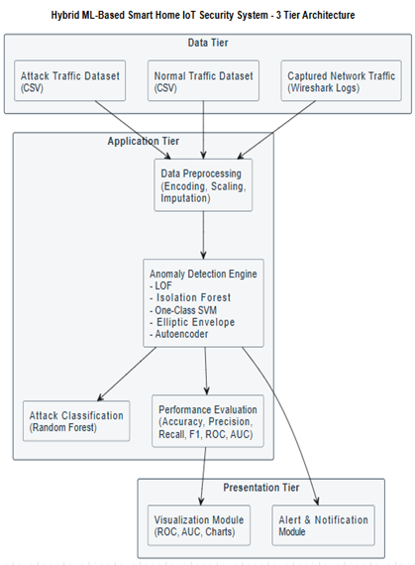
SYSTEM ARCHITECTURE
A Hybrid Machine Learning-Based Smart Home IoT Security System for Threat Detection, Classification, and Alert Mechanisms

Slide 29
VNR VIGNANA JYOTHI INSTITUTE OF ENGINEERING AND TECHNOLOGY
COMPUTER SCIENCE AND ENGINEERING DEPARTMENT
METHODOLOGY
1. Planning and System Setup
Define the smart home IoT environment using a smart bulb and ESP32 devices.
Select Wi-Fi network and MQTT protocol for communication.
Install and configure required tools such as MQTT broker and Wireshark.
Establish overall system architecture for data collection and analysis.
2. IoT Device Configuration
Connect ESP32 devices and smart bulb to the same Wi-Fi network.
Configure one ESP32 as MQTT publisher and another as subscriber.
Enable communication through the MQTT broker.
Ensure continuous data transmission between devices.
A Hybrid Machine Learning-Based Smart Home IoT Security System for Threat Detection, Classification, and Alert Mechanisms

Slide 30

VNR VIGNANA JYOTHI INSTITUTE OF ENGINEERING AND TECHNOLOGY
COMPUTER SCIENCE AND ENGINEERING DEPARTMENT
METHODOLOGY
3. Traffic Collection (Normal and Attack)
Operate devices under normal conditions and capture baseline traffic using Wireshark.
Perform controlled attacks such as replay, brute force, and MITM.
Capture network traffic during attack scenarios.
Store collected data as labeled normal and attack datasets.
4. Data Preprocessing and Feature Engineering
Remove empty and irrelevant features from the dataset.
Encode categorical features into numerical form.
Handle missing values using imputation techniques.
Apply feature scaling using standardization.
Remove highly correlated features to reduce redundancy.
Apply PCA for dimensionality reduction.
A Hybrid Machine Learning-Based Smart Home IoT Security System for Threat Detection, Classification, and Alert Mechanisms

Slide 31
VNR VIGNANA JYOTHI INSTITUTE OF ENGINEERING AND TECHNOLOGY
COMPUTER SCIENCE AND ENGINEERING DEPARTMENT
METHODOLOGY
5. Anomaly Detection and Attack Classification
Train Local Outlier Factor (LOF) model using only normal traffic.
Detect anomalies by identifying deviations from normal behavior.
Apply Random Forest classifier on detected anomalies.
Classify high-confidence predictions as known attack types.
Label low-confidence cases as abnormal pattern detected.
6. Detection, Alerting, and Performance Evaluation
Process incoming data through the same preprocessing pipeline.
Identify normal traffic, known attacks, and abnormal patterns.
Generate alerts and send email notifications for detected attacks.
Evaluate system performance using accuracy, precision, recall, and F1-score.
Analyze results and suggest improvements for IoT security.
A Hybrid Machine Learning-Based Smart Home IoT Security System for Threat Detection, Classification, and Alert Mechanisms

Slide 32
VNR VIGNANA JYOTHI INSTITUTE OF ENGINEERING AND TECHNOLOGY
COMPUTER SCIENCE AND ENGINEERING DEPARTMENT
SYSTEM
DESIGN
A Hybrid Machine Learning-Based Smart Home IoT Security System for Threat Detection, Classification, and Alert Mechanisms

Slide 33
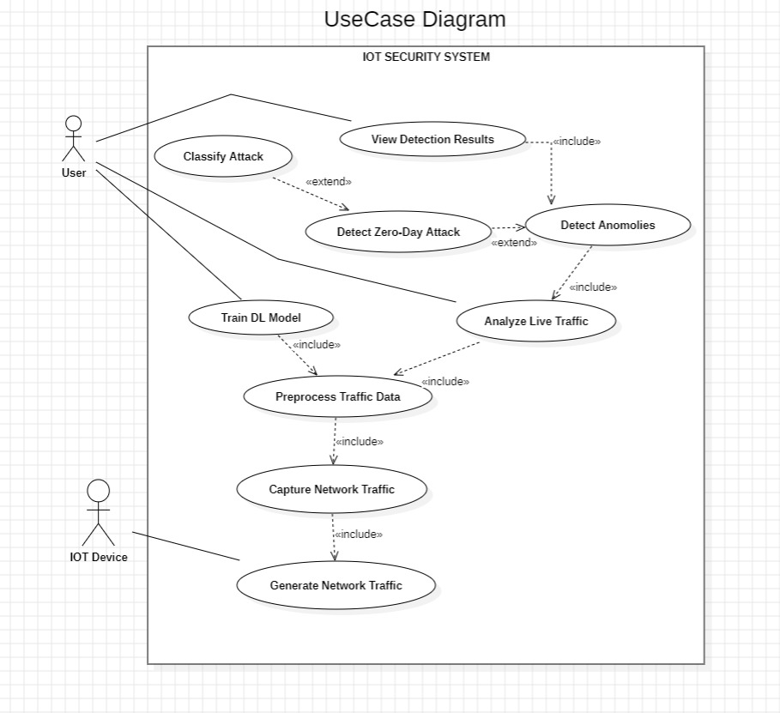
VNR VIGNANA JYOTHI INSTITUTE OF ENGINEERING AND TECHNOLOGY
COMPUTER SCIENCE AND ENGINEERING DEPARTMENT
THE DIAGRAM SHOWS AN IOT SECURITY SYSTEM WHERE A USER TRAINS THE MODEL, MONITORS LIVE TRAFFIC, AND VIEWS RESULTS. THE IOT DEVICE GENERATES NETWORK TRAFFIC WHICH IS CAPTURED AND ANALYZED BY THE SYSTEM FOR ANOMALY DETECTION AND ATTACK CLASSIFICATION.
A Hybrid Machine Learning-Based Smart Home IoT Security System for Threat Detection, Classification, and Alert Mechanisms

Slide 34
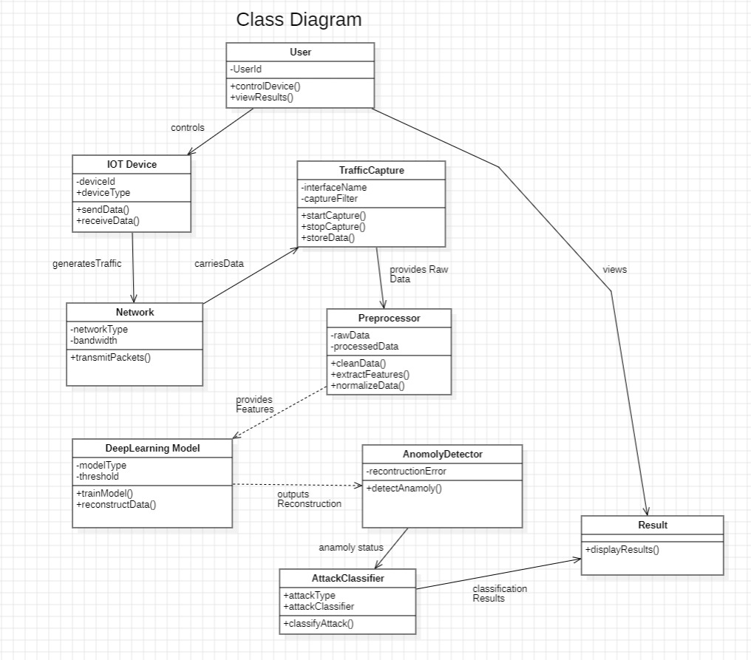
VNR VIGNANA JYOTHI INSTITUTE OF ENGINEERING AND TECHNOLOGY
COMPUTER SCIENCE AND ENGINEERING DEPARTMENT
THIS CLASS DIAGRAM SHOWS THE STRUCTURE OF THE IOT SECURITY SYSTEM. NETWORK TRAFFIC FROM THE IOT DEVICE IS CAPTURED, PREPROCESSED, AND ANALYZED BY THE DEEP LEARNING MODEL. THE ANOMALY DETECTOR AND ATTACK CLASSIFIER WORK TOGETHER TO GENERATE RESULTS FOR THE USER.
A Hybrid Machine Learning-Based Smart Home IoT Security System for Threat Detection, Classification, and Alert Mechanisms

Slide 35
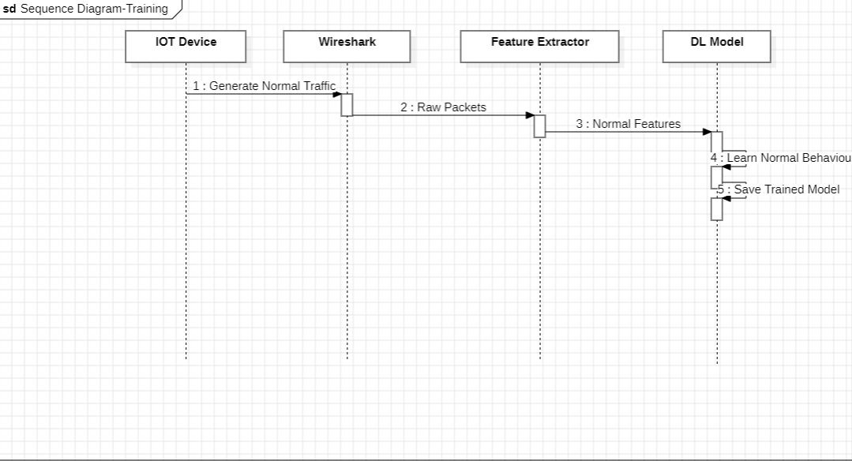
VNR VIGNANA JYOTHI INSTITUTE OF ENGINEERING AND TECHNOLOGY
COMPUTER SCIENCE AND ENGINEERING DEPARTMENT
THIS SEQUENCE DIAGRAM ILLUSTRATES THE WORKFLOW FOR TRAINING THE AUTOENCODER MODEL USING NORMAL IOT TRAFFIC. DATA IS CAPTURED, PREPROCESSED, AND USED TO TRAIN THE MODEL TO LEARN NORMAL TRAFFIC BEHAVIOR.
A Hybrid Machine Learning-Based Smart Home IoT Security System for Threat Detection, Classification, and Alert Mechanisms

Slide 36
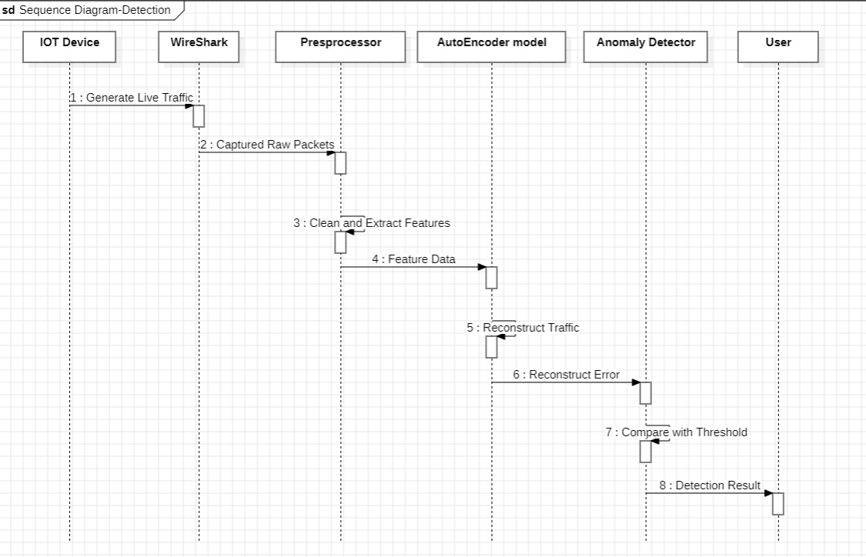
VNR VIGNANA JYOTHI INSTITUTE OF ENGINEERING AND TECHNOLOGY
COMPUTER SCIENCE AND ENGINEERING DEPARTMENT
THIS SEQUENCE DIAGRAM ILLUSTRATES THE PROCESS OF DETECTING ANOMALIES IN LIVE IOT TRAFFIC. CAPTURED DATA IS RECONSTRUCTED BY THE TRAINED MODEL, AND THE RECONSTRUCTION ERROR IS COMPARED WITH A THRESHOLD TO IDENTIFY ABNORMAL TRAFFIC.
A Hybrid Machine Learning-Based Smart Home IoT Security System for Threat Detection, Classification, and Alert Mechanisms

Slide 37
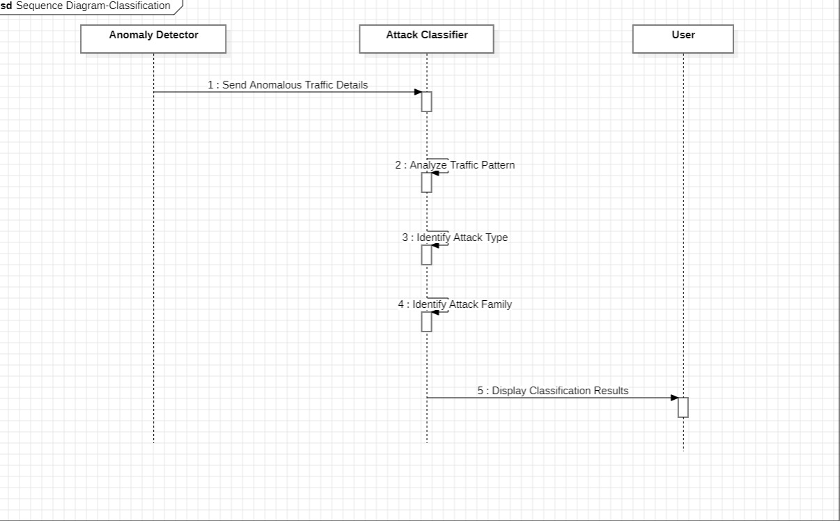
VNR VIGNANA JYOTHI INSTITUTE OF ENGINEERING AND TECHNOLOGY
COMPUTER SCIENCE AND ENGINEERING DEPARTMENT
THIS SEQUENCE DIAGRAM ILLUSTRATES THE PROCESS OF CLASSIFYING DETECTED ANOMALOUS TRAFFIC. THE SYSTEM ANALYZES TRAFFIC PATTERNS TO IDENTIFY THE ATTACK TYPE AND DISPLAYS THE RESULT TO THE USER.
A Hybrid Machine Learning-Based Smart Home IoT Security System for Threat Detection, Classification, and Alert Mechanisms

Slide 38
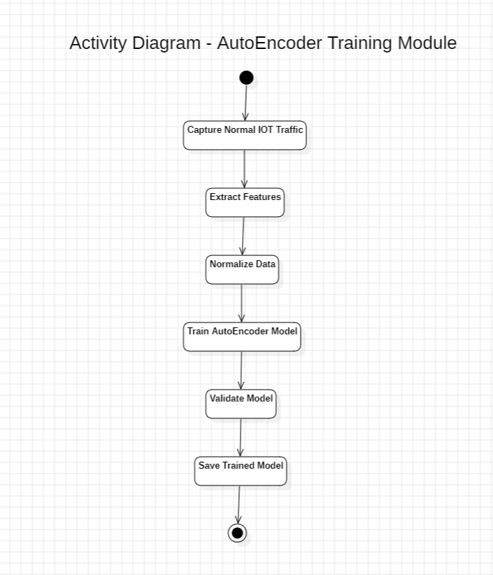
VNR VIGNANA JYOTHI INSTITUTE OF ENGINEERING AND TECHNOLOGY
COMPUTER SCIENCE AND ENGINEERING DEPARTMENT
THIS ACTIVITY DIAGRAM ILLUSTRATES THE FLOW OF TRAINING THE AUTOENCODER MODEL. NORMAL TRAFFIC IS CAPTURED, FEATURES ARE EXTRACTED, AND THE MODEL IS TRAINED AND SAVED.
A Hybrid Machine Learning-Based Smart Home IoT Security System for Threat Detection, Classification, and Alert Mechanisms

Slide 39
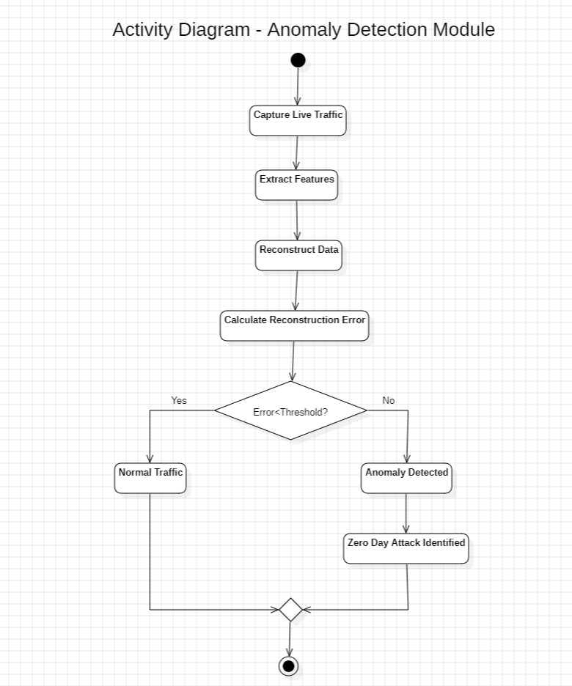
VNR VIGNANA JYOTHI INSTITUTE OF ENGINEERING AND TECHNOLOGY
COMPUTER SCIENCE AND ENGINEERING DEPARTMENT
THIS ACTIVITY DIAGRAM ILLUSTRATES THE FLOW OF REAL-TIME ANOMALY DETECTION. LIVE TRAFFIC IS ANALYZED USING THE TRAINED MODEL, AND TRAFFIC IS MARKED AS NORMAL OR ANOMALOUS BASED ON A THRESHOLD.
A Hybrid Machine Learning-Based Smart Home IoT Security System for Threat Detection, Classification, and Alert Mechanisms

Slide 40
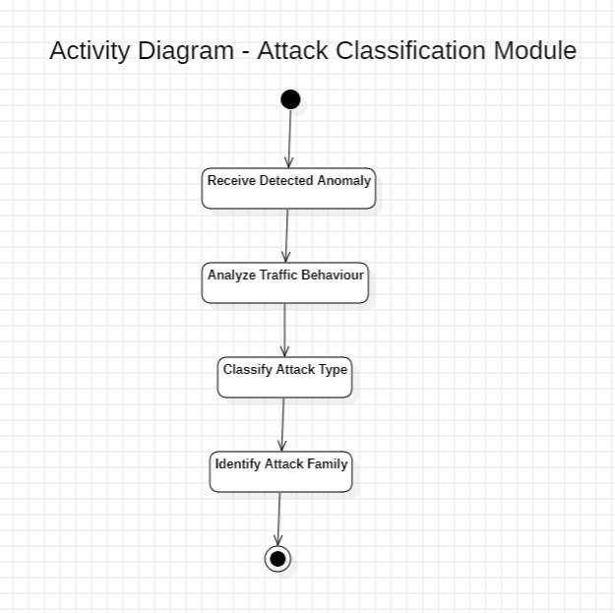
VNR VIGNANA JYOTHI INSTITUTE OF ENGINEERING AND TECHNOLOGY
COMPUTER SCIENCE AND ENGINEERING DEPARTMENT
THIS ACTIVITY DIAGRAM ILLUSTRATES THE PROCESS OF CLASSIFYING DETECTED ANOMALIES. THE SYSTEM ANALYZES THE TRAFFIC, IDENTIFIES THE ATTACK TYPE, AND GENERATES THE FINAL RESULT.
A Hybrid Machine Learning-Based Smart Home IoT Security System for Threat Detection, Classification, and Alert Mechanisms

Slide 41
IMPLEMENTATION
A Hybrid Machine Learning-Based Smart Home IoT Security System for Threat Detection, Classification, and Alert Mechanisms

Slide 42
VNR VIGNANA JYOTHI INSTITUTE OF ENGINEERING AND TECHNOLOGY
COMPUTER SCIENCE AND ENGINEERING DEPARTMENT
Overview of Implementation Steps
Step-wise Process
Capture IoT network traffic using Wireshark.
Preprocess data (cleaning, encoding, scaling, PCA).
Train LOF model on normal traffic for anomaly detection.
Train Random Forest classifier on attack data for classification.
During detection:
Identify anomalies using LOF
Classify attacks using Random Forest
Generate alerts and confidence scores
A Hybrid Machine Learning-Based Smart Home IoT Security System for Threat Detection, Classification, and Alert Mechanisms

Slide 43
VNR VIGNANA JYOTHI INSTITUTE OF ENGINEERING AND TECHNOLOGY
COMPUTER SCIENCE AND ENGINEERING DEPARTMENT
Algorithm 1: Anomaly Detection using LOF
Input: Preprocessed data
Output: Normal / Anomaly
1. Train LOF using normal data
2. For each incoming sample:
3. Apply preprocessing (imputer, scaler, PCA)
4. Predict using LOF
5. If prediction == -1:
6. Mark as Anomaly
7. Else:
8. Mark as Normal
A Hybrid Machine Learning-Based Smart Home IoT Security System for Threat Detection, Classification, and Alert Mechanisms

Slide 44
VNR VIGNANA JYOTHI INSTITUTE OF ENGINEERING AND TECHNOLOGY
COMPUTER SCIENCE AND ENGINEERING DEPARTMENT
Algorithm 2: Attack Classification using Random Forest
Input: Anomalous samples
Output: Attack type / Abnormal pattern
1. Train Random Forest using labeled attack data
2. For each anomalous sample:
3. Predict class probabilities
4. Get maximum probability (confidence)
5. If confidence >= threshold:
6. Classify as Known Attack
7. Else:
8. Classify as Abnormal Pattern Detected
A Hybrid Machine Learning-Based Smart Home IoT Security System for Threat Detection, Classification, and Alert Mechanisms

Slide 45
VNR VIGNANA JYOTHI INSTITUTE OF ENGINEERING AND TECHNOLOGY
COMPUTER SCIENCE AND ENGINEERING DEPARTMENT
PSEUDOCODE-MODEL TRAINING
-----------------------------
TRAIN LOF (Anomaly Detection)
-----------------------------
SELECT normal samples
FIT LOF model on normal data
EVALUATE LOF:
PREDICT on full dataset
COMPUTE accuracy, precision, recall, F1-score
GENERATE confusion matrix
COMPUTE ROC-AUC
-----------------------------
TRAIN RANDOM FOREST
-----------------------------
SELECT attack samples
ENCODE attack labels
BALANCE dataset using resampling
COMPUTE class weights
SPLIT into train and test
TRAIN Random Forest model
EVALUATE model:
COMPUTE accuracy, F1-score
PERFORM cross-validation
GENERATE confusion matrix
SAVE models:
LOF model
Random Forest model
preprocessing objects (imputer, scaler, PCA)
END
BEGIN
LOAD normal_data and attack_data
ADD label:
normal → 0
attack → 1
MERGE datasets
REMOVE empty columns
ENCODE categorical features
SEPARATE features (X) and labels (y)
REMOVE highly correlated features
SAVE feature column names
APPLY preprocessing:
IMPUTE missing values
SCALE features
APPLY PCA
SAVE preprocessed datasets
A Hybrid Machine Learning-Based Smart Home IoT Security System for Threat Detection, Classification, and Alert Mechanisms

Slide 46
VNR VIGNANA JYOTHI INSTITUTE OF ENGINEERING AND TECHNOLOGY
COMPUTER SCIENCE AND ENGINEERING DEPARTMENT
PSEUDOCODE-DETECTION AND ALERT SYSTEM
BEGIN
LOAD trained models:
LOF, Random Forest, label encoder
imputer, scaler, PCA
feature columns
LOAD new input data
REMOVE label column (if exists)
SELECT numeric features
ALIGN features with training columns
FILL missing columns
APPLY preprocessing:
IMPUTE
SCALE
APPLY PCA
------------------------------
ANOMALY DETECTION (LOF)
-----------------------------
FOR each sample:
PREDICT using LOF
IF prediction = normal:
PRINT "Normal Traffic"
ELSE:
MARK as anomaly
-----------------------------
ATTACK CLASSIFICATION
-----------------------------
FOR each anomaly sample:
PREDICT probabilities using Random Forest
COMPUTE confidence = max probability
IF confidence ≥ threshold:
LABEL as "Known Attack"
DISPLAY attack type
ELSE:
LABEL as "Abnormal Pattern Detected"
PRINT prediction and confidence
LOG alert
SEND email alert
SAVE final output results
END
A Hybrid Machine Learning-Based Smart Home IoT Security System for Threat Detection, Classification, and Alert Mechanisms

Slide 47
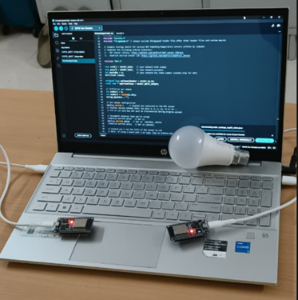
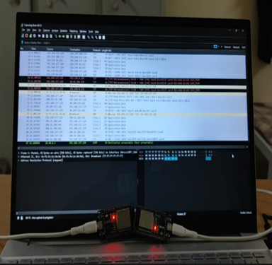
VNR VIGNANA JYOTHI INSTITUTE OF ENGINEERING AND TECHNOLOGY
COMPUTER SCIENCE AND ENGINEERING DEPARTMENT
A Hybrid Machine Learning-Based Smart Home IoT Security System for Threat Detection, Classification, and Alert Mechanisms

Slide 48
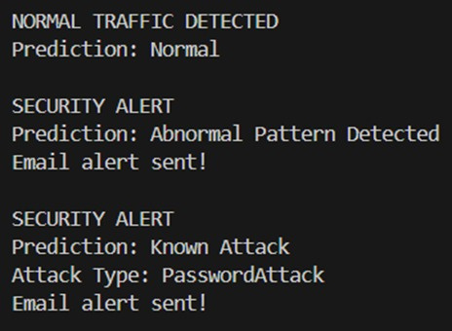
VNR VIGNANA JYOTHI INSTITUTE OF ENGINEERING AND TECHNOLOGY
COMPUTER SCIENCE AND ENGINEERING DEPARTMENT
A Hybrid Machine Learning-Based Smart Home IoT Security System for Threat Detection, Classification, and Alert Mechanisms

Slide 49
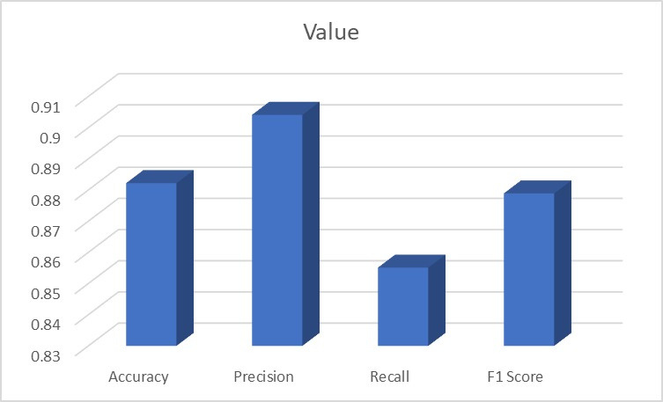
VNR VIGNANA JYOTHI INSTITUTE OF ENGINEERING AND TECHNOLOGY
COMPUTER SCIENCE AND ENGINEERING DEPARTMENT
Model Testing (Metrics)
The performance evaluation of the LOF model demonstrates strong capability in detecting anomalies within IoT network traffic. The model achieves an accuracy of approximately 88.8%, indicating reliable overall performance. A precision of around 91.0% shows that the system is highly effective in correctly identifying attack traffic with fewer false alarms. However, the recall is slightly lower at about 85.6%, suggesting that some attack instances are not detected. The F1 score of approximately 88.2% reflects a good balance between precision and recall, indicating stable and consistent performance.
A Hybrid Machine Learning-Based Smart Home IoT Security System for Threat Detection, Classification, and Alert Mechanisms

Slide 50
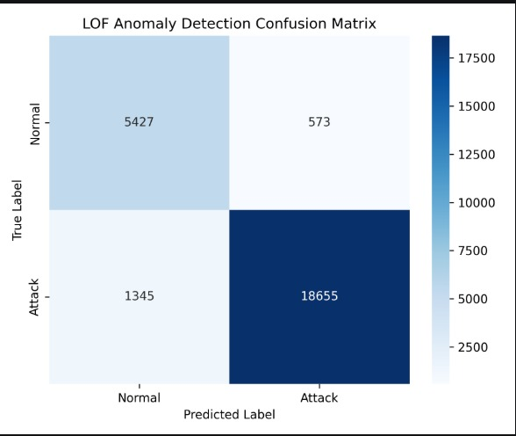
VNR VIGNANA JYOTHI INSTITUTE OF ENGINEERING AND TECHNOLOGY
COMPUTER SCIENCE AND ENGINEERING DEPARTMENT
Model Testing (Metrics)
The confusion matrix provides insight into the model’s performance, showing that 5,427 normal instances are correctly classified as normal, while 573 normal instances are incorrectly flagged as attacks (false positives). Similarly, 18,655 attack instances are correctly detected, whereas 1,345 attack instances are misclassified as normal (false negatives). These results indicate that the model is highly effective in detecting attack instances with a strong true positive rate, while maintaining relatively low false positives; however, there is still scope for improvement in reducing missed attacks. Overall, the LOF model demonstrates solid performance for anomaly detection in IoT environments, achieving a good balance between accurate attack detection and minimizing false alarms.
A Hybrid Machine Learning-Based Smart Home IoT Security System for Threat Detection, Classification, and Alert Mechanisms

Slide 51
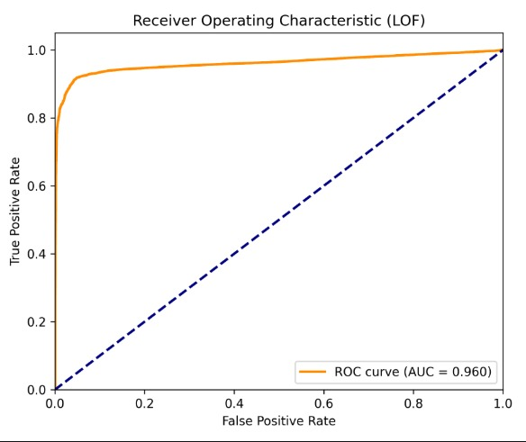
VNR VIGNANA JYOTHI INSTITUTE OF ENGINEERING AND TECHNOLOGY
COMPUTER SCIENCE AND ENGINEERING DEPARTMENT
Model Testing (Evaluation Technique)
The ROC curve shows the performance of the LOF model in detecting anomalies.
It plots True Positive Rate (TPR) vs False Positive Rate (FPR).
The curve is close to the top-left corner, indicating high detection accuracy.
The model achieves high true positives with low false positives.
It performs significantly better than random classification (diagonal line).
A Hybrid Machine Learning-Based Smart Home IoT Security System for Threat Detection, Classification, and Alert Mechanisms

Slide 52
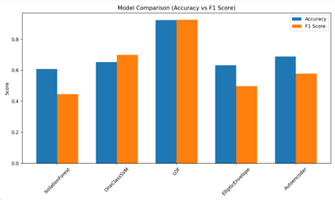
VNR VIGNANA JYOTHI INSTITUTE OF ENGINEERING AND TECHNOLOGY
COMPUTER SCIENCE AND ENGINEERING DEPARTMENT
Detailed Result Analysis
The graph compares different anomaly detection models based on accuracy and F1 score, where the Local Outlier Factor (LOF) achieves the highest performance with values around 0.88–0.89, indicating strong capability in distinguishing normal and attack traffic. The Autoencoder also performs well but slightly below LOF, while One-Class SVM shows moderate performance with balanced results. Elliptic Envelope performs lower, especially in F1 score, and Isolation Forest shows the weakest performance, indicating higher misclassification. Overall, the results highlight that LOF is the most effective model for IoT anomaly detection, and while accuracy provides general performance insight, F1 score gives a better understanding of model effectiveness.
A Hybrid Machine Learning-Based Smart Home IoT Security System for Threat Detection, Classification, and Alert Mechanisms

Slide 53
VNR VIGNANA JYOTHI INSTITUTE OF ENGINEERING AND TECHNOLOGY
COMPUTER SCIENCE AND ENGINEERING DEPARTMENT
CONCLUSION
The implementation of the IoT-based Smart Home Security System successfully demonstrates an automated approach for detecting and classifying cyber threats in real-time network traffic. By integrating IoT communication (ESP32 and smart bulb), network traffic analysis, and a hybrid machine learning framework combining Local Outlier Factor (LOF) for anomaly detection and Random Forest for attack classification, the system achieves accurate identification of normal behavior, known attacks, and abnormal patterns. The use of a consistent preprocessing pipeline ensures reliable and stable predictions, while confidence-based decision logic improves the handling of uncertain scenarios. The inclusion of an automated email alert mechanism further enhances responsiveness and practical usability. The results validate the effectiveness, reliability, and scalability of the proposed approach, while also highlighting opportunities for future enhancements such as improved classification accuracy, real-time streaming integration, and advanced zero-day attack detection techniques.
A Hybrid Machine Learning-Based Smart Home IoT Security System for Threat Detection, Classification, and Alert Mechanisms

Slide 54
VNR VIGNANA JYOTHI INSTITUTE OF ENGINEERING AND TECHNOLOGY
COMPUTER SCIENCE AND ENGINEERING DEPARTMENT
FUTURE SCOPE
Scalability to Larger IoT Environments: Extend the system to support multiple IoT devices and more complex smart home or industrial IoT networks.
Advanced Alert and Monitoring System: Develop a web-based dashboard and improve alert mechanisms for better visualization and faster response.
Federated Learning for Distributed IoT Security: Implement federated learning to train models across multiple IoT devices without sharing raw data, improving privacy and scalability.
Adaptive and Self-Learning Detection System:Develop a system that continuously learns from new network traffic and automatically updates the model to adapt to evolving attack patterns.
A Hybrid Machine Learning-Based Smart Home IoT Security System for Threat Detection, Classification, and Alert Mechanisms

Slide 55
VNR VIGNANA JYOTHI INSTITUTE OF ENGINEERING AND TECHNOLOGY
COMPUTER SCIENCE AND ENGINEERING DEPARTMENT
WORK PLAN
PHASE 1: IOT SYSTEM SETUP (WEEKS 17–20)
PHASE 2:DATA GENERATION (WEEKS 21–24)
PHASE 3: FEATURE EXTRACTION & PREPROCESSING(WEEKS 25–28)
PHASE 4: ANOMALY DETECTION MODEL DEVELOPMENT & BENCHMARKING (WEEKS 29–31)
PHASE 5: SECURITY MECHANISM IMPLEMENTATION & RESULT ANALYSIS (WEEKS 32–33)
PHASE 6: DOCUMENTATION, REPORT WRITING(WEEK 34)
A Hybrid Machine Learning-Based Smart Home IoT Security System for Threat Detection, Classification, and Alert Mechanisms

Slide 56
VNR VIGNANA JYOTHI INSTITUTE OF ENGINEERING AND TECHNOLOGY
COMPUTER SCIENCE AND ENGINEERING DEPARTMENT
REFERENCES
S. S. R. DEPURU, A. G. REDDY, AND L. M. PATNAIK, “A MACHINE LEARNING ATTACK-RESISTANT PUF-BASED ROBUST AND EFFICIENT MUTUAL AUTHENTICATION SCHEME IN FOG-ENABLED IOT ENVIRONMENTS,” IEEE ACCESS, VOL. 9, PP. 1–15, 2021.
A. K. SIKDER, G. PETRACCA, H. AKSU, T. JAEGER, AND A. S. ULUAGAC, “A SURVEY OF PUBLIC IOT DATASETS FOR NETWORK SECURITY RESEARCH,” ARXIV PREPRINT ARXIV:1905.01727, 2019.
C. LAI, X. MA, J. DENG, AND R. LU, “SMART HOME SECURITY: AN EFFICIENT MULTI-FACTOR AUTHENTICATION PROTOCOL FOR IOT,” IEEE INTERNET OF THINGS JOURNAL, VOL. 8, NO. 2, PP. 1–13, 2021.
CISCO, “SMART HOME SECURITY SIMULATION IN PACKET TRACER,” CISCO NETWORKING ACADEMY RESOURCES, 2020.
A Hybrid Machine Learning-Based Smart Home IoT Security System for Threat Detection, Classification, and Alert Mechanisms

Slide 57
VNR VIGNANA JYOTHI INSTITUTE OF ENGINEERING AND TECHNOLOGY
COMPUTER SCIENCE AND ENGINEERING DEPARTMENT
REFERENCES
M. AMMAR, G. RUSSELLO, AND B. CRISPO, “INTERNET OF THINGS: A SURVEY ON THE SECURITY OF IOT FRAMEWORKS,” JOURNAL OF INFORMATION SECURITY AND APPLICATIONS, VOL. 38, PP. 8–27, 2018.
J. GRANJAL, E. MONTEIRO, AND J. SILVA, “SECURITY FOR THE INTERNET OF THINGS: A SURVEY OF EXISTING PROTOCOLS AND OPEN RESEARCH ISSUES,” IEEE COMMUNICATIONS SURVEYS & TUTORIALS, VOL. 17, NO. 3, PP. 1294–1312, 2015.
A. K. SIKDER, H. AKSU, AND A. S. ULUAGAC, “IOT-AD: A FRAMEWORK FOR ANOMALY DETECTION IN IOT NETWORKS,” ARXIV PREPRINT ARXIV:2306.06764, 2023.
M. GUPTA, J. GAO, AND R. G. CID-FUENTES, “SECURING MQTT ECOSYSTEM: EXPLORING VULNERABILITIES, MITIGATIONS, AND FUTURE TRAJECTORIES,” SENSORS, VOL. 24, NO. 9, PP. 2781–2797, 2024.
A Hybrid Machine Learning-Based Smart Home IoT Security System for Threat Detection, Classification, and Alert Mechanisms

Slide 58
THANK YOU

